Slide 1

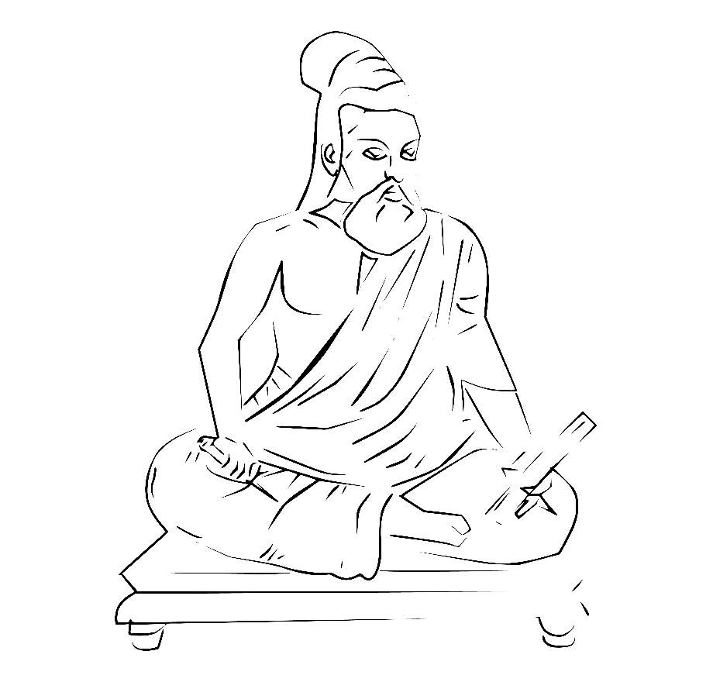



Tamil Nadu
Welcomes you

Slide 2


About Azure Developer
Community
https://azdev.konfhub.com/
Operating in over 100+ cities in India
Over 3500+ members
Powered by
Sponsored by

Slide 3
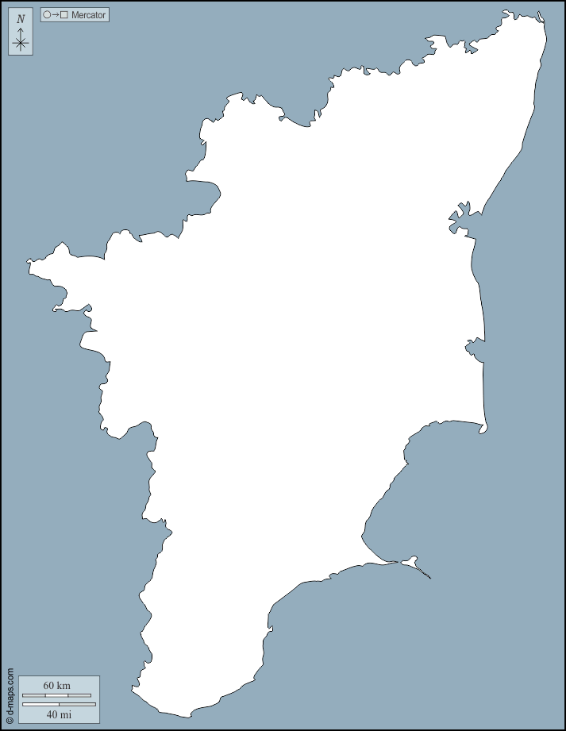
Tanjavur
Chennai
Thoothukudi
Madurai
Coimbatore
Thiruchirapalli
12 Communities
Erode
Thirunelveli
Dindigul
Tiruppur
Salem
Vellore

Slide 4
What we do?
Online Meetups
Network of Beginners, Professionals & Experts
Azure Cert Study Jam

Slide 5
What we do?
Corporate / Startup Talk
Podcasts
Fun contests

Slide 6

The stage is always yours

Slide 7


About me
From Madurai, Tamil Nadu
Data Scientist @ CortexBCI Inc | Nexstem
Organizer at Azure Developer Communities – Tamil Nadu
Microsoft Certified Azure Data Scientist, AI Engineer and Data Engineer
15x Multi—Cloud Certified
20 times International & National Hackathon winner
Published 5+ Research papers, + 1 patent (AI & IoT)
Active Speaker, Mentor, Blogger, Open-source Contributor
@VivekRaja007

Slide 8



Check out my awesome blogs &repos
Building End to End COVID-19 Forecast Model using Azure ML
Literature Text Translation & Audio Synthesis using Microsoft Azure Cognitive Services
Creating COVID19 stats newsletter using Azure Function Apps
@vivekraja98
@Vivek0712

Slide 9
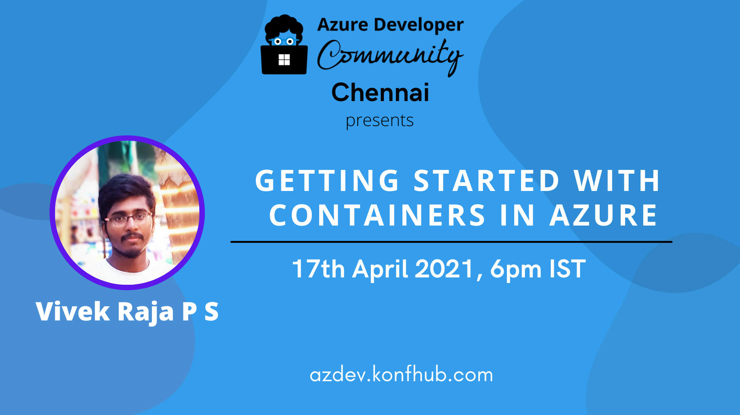

Slide 10

What are containers?

Slide 11
What are containers?
A solution for creating and configuring deployment environments, and simplify the software deployment process.
Helps to convert monolith to Service based Applications

Slide 12

Microservices & Containers

Slide 13

Example 1
Search Engine
Recommendation Engine
Music Player
Playlist Generation
User Account Maintainance
This Photo by Unknown Author is licensed under CC BY-SA

Slide 14

Example 2
Search Engine
Recommendation Engine
Price Tag Generation
Shopping Cart
This Photo by Unknown Author is licensed under CC BY-SA-NC

Slide 15

Example 3
Route Calculation
Fare Calculation
Assigning Drivers
Ride Tracking
Chat & Support

Slide 16
Scenario
Development
Operations
QA Team
Pre-production
Production

Slide 17
Challenges?
Management of hosting environments
Continuity in software delivery
Efficient use of hardware
Application portability

Slide 18

Solution - Containers

Slide 19
Terminology -Containers
A container is a loosely isolated environment that allows us to build and run software packages.
These software packages include the code and all dependencies to run applications quickly and reliably on any computing environment. We call these packages container images.

Slide 20
Terminology – Software Containerization
OS virtualization method that is used to deploy and run containers
Containers can run on physical hardware, in the cloud, VMs, and across multiple OSs.

Slide 21

Terminology – Docker
Docker is a containerization platform used to develop, ship, and run containers.

Slide 22
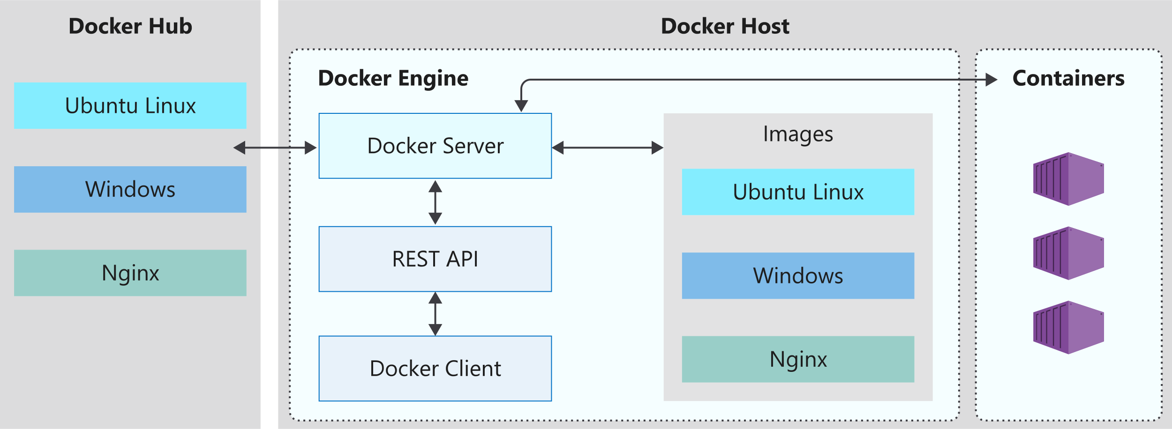
Docker Architecture

Slide 23
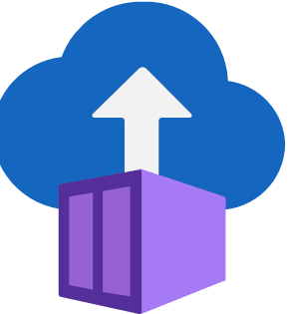
Azure Container Instances
Fast startup: Launch containers in seconds.
Per second billing: Incur costs only while the container is running.
Hypervisor-level security: Isolate your application as completely as it would be in a VM.
Custom sizes: Specify exact values for CPU cores and memory.
Persistent storage: Mount Azure Files shares directly to a container to retrieve and persist state.
Linux and Windows: Schedule both Windows and Linux containers using the same API.

Slide 24

Talk is cheap, show me the demo!

Slide 25
Tutorial Steps
1. Create your Azure Account
2. n search bar, type “Container Instances”
3. Click “ Create Container Instances”
4. Give relevant details of name and resource group
5. Select your container image
I6. n Networking tab, give DNS name of the container
7. Click “Review and Create”
8. Launch your website running on container

Slide 26

Congrats on creating your first Azure Container Instance

Slide 27

Questions & Answers

Slide 28
Next steps…
Develop and containerize microservices
Refer to our Github Samples and Microsoft Learn paths
Worry not, Ameer Jhan is here to guide you on our next meetup on May 29th

Slide 29
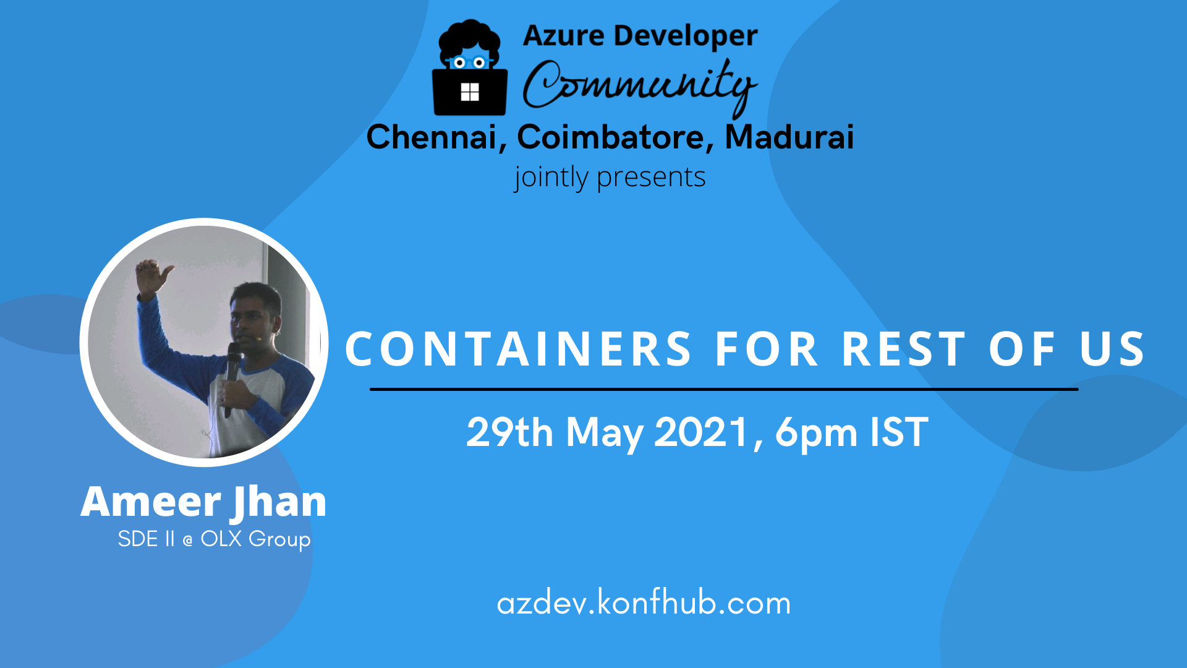

Slide 30

Contest-1

Slide 31
Contest – 1 Blogging Contest
Write a blog on anything related to Microsoft Azure.
Post your blog in Linkedin or Twitter by tagging @Azdevindia or @VivekRaja007
All blogs will get featured in Meetup Weekly newsletter.
Best blog will receive a prize (preferably Azure Passes or Azure Certification Voucher) and may get featured in Official Microsoft Newsletter

Slide 32

Missed attending any meetups?
Access to presentation decks?
Stats of every meetup?
Wants to start collaborative Open-source project?
Study Resources for Azure?
Code repos for your blogs?
Got some cool memes?
We got you covered!!
https://github.com/Vivek0712/azdev-tn

Slide 33



Find us on
https://azdev.konfhub.com/

Slide 34
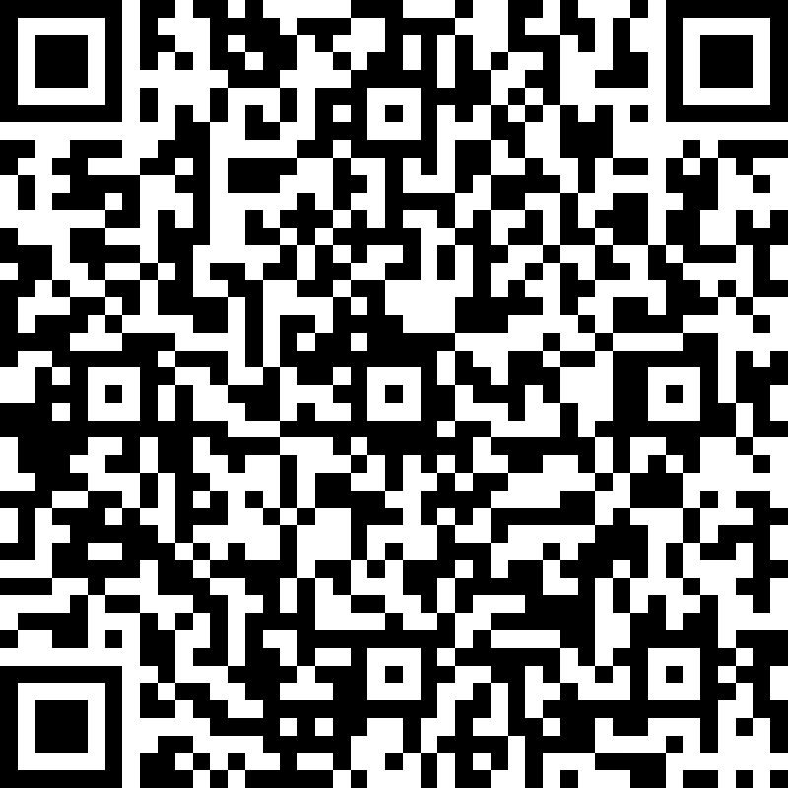
Feedback
http://bit.ly/azdevtn-1

Slide 35

Until next time…

Slide 36

Thank you நன்றி

